Slide 1
Lecture #2a: Data Engineering

Slide 2
Outline
Part A: focus on data and relational storage
How do we engineer features from the web?
What is a relational Database?
What Grammar of Data does it follow?
How is this grammar implemented in Pandas?
Part B: focus on the visualization part of EDA.
In reality, both go together

Slide 3
It took about three years
before the BellKor’s Pragmatic
Chaos team managed to win
the prize ... The winning
algorithm was ... so complex
that it was never implemented
by Netflix.¹
¹ https://hbr.org/2012/10/big-data-hype-and-reality

Slide 6
Data Engineering
data: scraping, API, feature engineering, all part of EDA
compute: code, python, R, julia, spark, hadoop
storage/database: pandas, SQL, NoSQL, HBase, disk, memory
devops: AWS, docker, mesos, repeatability
product: database, web, API, viz, UI, story
Different at different scales....

Slide 8
The basic EDA workflow¹
Build a DataFrame from the data (ideally, put all data in this object)
Clean the DataFrame. It should have the following properties:
Each row describes a single object
Each column describes a property of that object
Columns are numeric whenever appropriate
Columns contain atomic properties that cannot be further decomposed
Explore global properties. Use histograms, scatter plots, and aggregation functions to summarize the data.
Explore group properties. Use groupby, queries, and small multiples to compare subsets of the data.
¹enunciated in this form by Chris Beaumont, the first Head TF of cs109

Slide 9
Relational Database

Slide 10
Relational Database
Don't say_: seek 20 bytes onto disk and pick up from there. The next row is 50 bytes hence
Say: select data from a set. I don't care where it is, just get the row to me.
It’s just the table Kevin talked about last time …

Slide 11
Relational Database
A collection of tables related to each other through common data values.
Rows represent attributes of something
Everything in a column is values of one attributes
A cell is expected to be atomic
Tables are related to each other if they have columns called keys which represent the same values

Slide 12
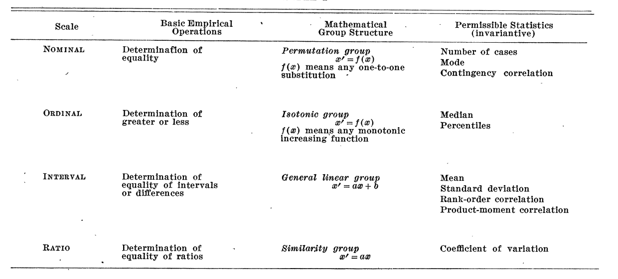
Scales of Measurement¹
Quantitative (Interval and Ratio)
Ordinal
Nominal
¹ S. S. Stevens, Science, New Series, Vol. 103, No. 2684 (Jun. 7, 1946), pp. 677-680

Slide 13
Grammar of Data

Slide 14
Grammar of Data
Been there for a while (SQL, Pandas), formalized in
dplyr⁴:
provide simple verbs for simple things. These are func8ons corresponding tO common data manipulation tasks.
second idea is that backend does not matter. Here we constrain ourselves to Pandas.
multiple backends implemented in Pandas, Spark, Impala, Pig, dplyr, ibis, blaze
⁴ Hadley Wickham: https://cran.rstudio.com/web/packages/dplyr/vigne0es/introducton.html

Slide 15
Grammar of Data
Why bother?
learn how to do core data manipula2ons, no matter what the system
relational databases cri2cal for non-memory fits. Big installed base.
one off questions: google, stack-overflow, http://chrisalbon.com

Slide 16
Grammar of Data
For cleaning and for transforma1on:

Slide 17
Grammar of Data
Example: Candidates

Slide 18
Grammar of Data
Contributors

Slide 19
Grammar of Data
Operations:
QUERY: dfcwci[(dfcwci.state=='VA') & (dfcwci.amount < 400)]
SORT: dfcwci.sort_values(by="amount", ascending=False)
SELECT-COLUMNS: dfcwci[['first_name', 'amount']]
SELECT-DISTINCT: dfcwci[['last_name','first_name']].drop_duplicates()
ASSIGN: dfcwci['name']=dfcwci['last_name']+", "+dfcwci['first_name']
ASSIGN(in-place): dfcwci.loc[dfcwci.state=='VA', 'name']="junk”
AGGREGATE: dfcwci.amount.max(), dfcwci.describe() DELETE: del dfcwci['name'] (DROPCOLUMN)

Slide 20
Grammar of Data
Split-Apply-Combine:
GROUP-AGG
splitting the data into groups based on some criteria
applying a function to each group independently
combining the results into a data structure

Slide 21
Grammar of Data
RELATIONSHIPS (in addition to rubric)
we usually need to combine data from multiple sources
different systems have different ways, most copy SQL (pandas)
sub-select:
obamaid=dfcand.query("last_name=='Obama'")['id'].values[0]
obamacontrib=dfcwci.query("candidate_id==%i" % obamaid)

Slide 22
Grammar of Data
JOINS:
combine tables on a common key-value
90% of the time, EXPLICIT INNER JOIN

Slide 23
Web Servers
A server is a long running process (also called daemon) which listens on a pre-specified port
and responds to a request, which is sent using a protocol called HTTP
A browser must first we must parse the url. Everything after a # is a fragment. Untill then it’s the DNS name or ip address, followed by the URL.

Slide 24
Web Servers
Example:
Our notebooks also talk to a local web server on our machines: http://localhost:8888/Documents/cs109/BLA.ipynb#something
protocol is http, hostname is localhost, port is 8888
url is /Documents/cs109/BLA.ipynb
url fragment is #something
Request is sent to localhost on port 8888. It says:
Request: GET /request-URI HTTP/version

Slide 25
Example with Response: Google
GET / HTTP/1.0
Host: www.google.com
HTTP/1.0 200 OK
Date: Mon, 14 Nov 2016 04:49:02 GMT
Expires: -1
Cache-Control: private, max-age=0
Content-Type: text/html; charset=ISO-8859-1
P3P: CP="This is ..."
Server: gws
X-XSS-Protection: 1; mode=block
X-Frame-Options: SAMEORIGIN
Set-Cookie: NID=90=gb5q7b0...; expires=Tue, 16-May-2017 04:49:02 GMT; path=/; domain=.google.com; HttpOnly
Accept-Ranges: none
Vary: Accept-Encoding
<!doctype html><html itemscope=""
itemtype="http://schema.org/WebPage" lang="en">
<head><meta content="Search the world's information,

Slide 26
HTTP Status Codes¹
• 200 OK:
Means that the server did whatever the client wanted it to, and all is well.
• 201 Created:
The request has been fulfilled and resulted in a new resource being created. The newly created resource can be referenced by the URI(s) returned in the enpty of the response, with the most specific URI for the resource given by a Location header field.
• 400: Bad request
The request sent by the client didn't have the correct syntax.
• 401: Unauthorized
Means that the client is not allowed to access the resource. This may change if the client retries with an authorization header.
• 403: Forbidden
The client is not allowed to access the resource and authorizaton will not help.
• 404: Not found
Seen this one before? :) It means that the server has not heard of the resource and has no further clues as to what the client should do about it. In other words: dead link.
• 500: Internal server error
Something went wrong inside the server.
• 501: Not implemented
The request method is not supported by the server
¹from http://www.garshol.priv.no/download/text/http-tut.htm)

Slide 27
Web Servers
Requests:
great module built into python for http requests
req=requests.get(“https://en.wikipedia.org/wiki/Harvard_University”)
<Response [200]>
page = req.text
'<!DOCTYPE html>\n<html class="client-nojs" lang="en" dir="ltr">\n<head>\n<meta charset="UTF-8"/>\n<title>Harvard University -Wikipedia</title>\n<script>document.documentElement.className=document.documentElement.className.replace( /(^|\\s)client-nojs(\\s|$)/,"$1client-js$2"
);</script>\n<script>(window.RLQ=window.RLQ||[]).push(function(){mw.config.set({
"wgCanonicalNamespace":"","wgCanonicalSpecialPageName":false,"wgNamespaceNumber"
:0,"wgPageName":"Harvard_University","wgTitle":"Harva...'

Slide 29
Python data scraping

Slide 30
Python data scraping
Why scrape the web?
vast source of information, combine with other data sets
companies have not provided APIs
automate tasks
keep up with sites
fun!

Slide 31
Python data scraping
copyrights and permission:
be careful and polite
give credit
care about media law
don't be evil (no spam, overloading sites, etc.)

Slide 32
Python data scraping
Robots.txt
specified by web site owner
gives instructions to web robots (aka your script)
is located at the top-level directory of the web server
e.g.: http://google.com/robots.txt

Slide 33
HTML
angle brackets
should be in pairs, eg <p>Hello</p>
maybe in implicit bears, such as <br/>
<!DOCTYPE html>
<html>
<head>
<title>Title</title>
</head>
<body>
<h1>Body Title</h1>
<p >Body Content</p>
</body>
</html>

Slide 34
Developer Tools
ctrl/cmd shi- i in chrome
cmd-option-i in safari
look for "inspect element"
locate details of tags

Slide 35
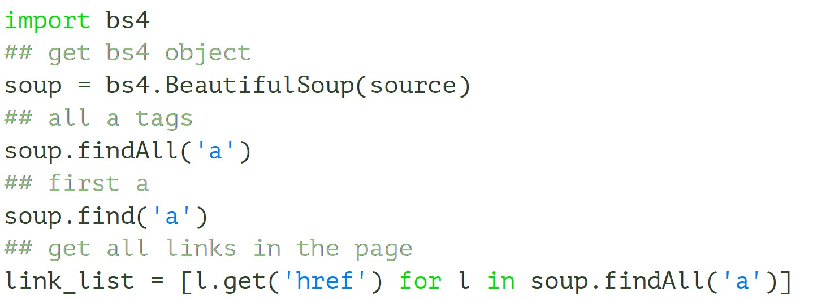
Beautiful Soup
will normalize dirty html
basic usage

Slide 36
HTML is a tree
tree = bs4.BeautifulSoup(source)
## get html root node
root_node = tree.html
## get head from root using contents
head = root_node.contents[0]
## get body from root
body = root_node.contents[1]
## could directly access body
tree.body

Slide 37
Demographics table we want

Slide 38
Table with sole class wikitable

Slide 39
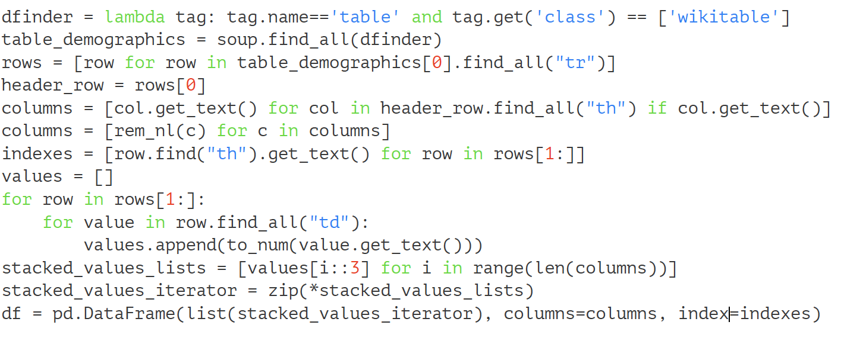
Beautiful Soup Code

